Slide 1
Valuation and Forecasting Model for Residential Properties
Ujjawal Dwivedi

Slide 2

How do neighborhood signals and national indicators jointly move market prices, changing whether a home’s feature-adjusted value trades quickly or requires price cuts?

Slide 3
THE AVA
Adaptive Valuation Algorithm (AVA) — a spatiotemporal pricing engine that learns neighborhood and national market dynamics to estimate fair, explainable home values in real time.
AVA fuses property attributes (beds, baths, sqft, age), neighborhood signals (schools, comps, walkability, inventory), and macro indicators (mortgage rates, unemployment) into a ZIP×month market index, then prices each home by its feature-adjusted position relative to that evolving “waterline.”
Built with leakage-safe time keys, monotone-constrained GBDTs + a regularized hedonic head, AVA delivers stable OOT MAPE/RMSE, calibrated tails (quantile loss optional), and SHAP-based transparency for decision support

Slide 4
Components
Latent Manifold Model
ZIP/Month + hedonic Model
The AVA has been built using neural networks and classical machine learning models.

Slide 5
Adaptive Valuation Algorithm
Latent Manifold Model
Zip/based Hedonic Model
Dual Architecture with a latent structure
Energy based Learning
Robust XGBoost-Huber Ensemble
Momentum and Liquidity feature pack
LME structure
Hedonic structure

Slide 6
Latent Manifold Model
Input Variables and Parameters:
◦ X: Feature vector associated with the house.
◦ Y: Actual log price.
◦ W: Parameters of the parametric model G.
2. Parametric Model (Intrinsic Price): G(W,X) takes the features X and parameters W to produce the log of the intrinsic price m.
m=G(W,X)
3 .Non-Parametric Model (Desirability Manifold): H(D,X) takes the sample X and the desirability vector D to produce an estimate of the desirability h for location X.
h=H(D,X)
4. Prediction Function J (Predicted Log Price p): The outputs m and h are combined additively.
J(m,h)=J(G(W,X),H(D,X)
p=G(W,X)+H(D,X)

Slide 7
Kernel Interpolation : h = H(D,X) = ∑j∈N(X)Ker(X,Xj) djh=H(D,X)=j∈N(X)∑​Ker(X,Xj​)dj​
Kernel Function
Ker(X,Xj) = exp⁡ ⁣(−q ∥X−Xj∥2)∑k∈N(X)exp⁡ ⁣(−q ∥X−Xk∥2)Ker(X,Xj​)=∑k∈N(X)​exp(−q∥X−Xk​∥2)exp(−q∥X−Xj​∥2)​
Weighted Local Linear Regression Find (β\*,α\*)(β\*,α\*) that minimize:
(β\*,α\*) = arg⁡min⁡β, α ∑j∈N(X)(dj−(β+α⊤Xj))2 Ker(X,Xj)(β\*,α\*)=argβ,αmin​j∈N(X)∑​(dj​−(β+α⊤Xj​))2Ker(X,Xj​)
Then the estimate is:
h = H(D,X) = β\*+α\*⊤X
Equivalent linear-combination form:
h = ∑j∈N(X)aj djh=j∈N(X)∑​aj​dj​
Absolute Relative Forecasting Error (per sample)
fe,i = ∣Ai−Pri∣ ∣Ai∣ fe,i​=∣Ai​∣∣Ai​−Pri​∣​
where AiAi​ is the actual price and PriPri​ is the predicted price.

Slide 8
Energy Function E(W, D, Y, X): The discrepancy between the actual log price (Y) and the predicted log price (p=m+h) is measured by the energy function, defined as half of the square of the Euclidean distance.
E(W,D,Y,X)= (Y−(m+h))/2
E(W,D,Y,X)= (Y−(G(W,X)+H(D,X)))/2
Over all Loss Function L(W,D)=i=1∑n E(W,D,Y,Xi)+R(D)
Regularizer R(D): An L2 regularizer is used to prevent the desirabilities from varying wildly and enforce smoothness.
R(D)=r/2 ∣∣D∣∣ , (where r is the regularization coefficient)
Standard Phase-1 Loss L1(D)L1​(D) — Sparse QP
L1(D) = r2 ∥D∥2 + 12∑i=1n(Yi−(mi+D⊤Ui))2L1​(D)=2r​∥D∥2+21​i=1∑n​(Yi​−(mi​+D⊤Ui​))2
S-LME Phase-1 Loss L1(D)L1​(D) — With Explicit Smoothing/Self-Consistency
L1(D) = r12 ∥D∥2 + 12∑i=1n(Yi−(mi+D⊤Ui))2 + r22∑i=1n(di−D⊤Ui)2L1​(D)=2r1​​∥D∥2+21​i=1∑n​(Yi​−(mi​+D⊤Ui​))2+2r2​​i=1∑n​(di​−D⊤Ui​)2

Slide 9
ZIP/Month + Hedonic Model
Target Variable (Forward Log-Deltas)
Short horizon (H1 ≈ 30d): YH1=log⁡ ⁣(1+IDXt+1)−log⁡ ⁣(1+IDXt)YH1​=log(1+IDXt+1​)−log(1+IDXt​)
Medium horizon (H2 ≈ 60d): YH2=log⁡ ⁣(1+IDXt+2)−log⁡ ⁣(1+IDXt)YH2​=log(1+IDXt+2​)−log(1+IDXt​)
Feature Pack A1–A3 (Momentum · Affordability · Liquidity)
A1. Momentum
Index momentum ( IDX_MOMkIDX_MOMk​, k∈{1,3,6}k∈{1,3,6} ): IDX_MOMk=IDXtIDXt−k−1IDX_MOMk​=IDXt−k​IDXt​​−1
Index volatility ( IDX_VOL3,6IDX_VOL3,6​ ): rolling std of IDX over 3/6 months.
A2. Affordability
Affordability ratio ( AFFORD_RATIOAFFORD_RATIO ): AFFORD_RATIO=MEDIAN_LISTING_PRICE__MEDIANINCOMEPERHOUSEHOLD__MEAN/12AFFORD_RATIO=INCOMEPERHOUSEHOLD__MEAN/12MEDIAN_LISTING_PRICE__MEDIAN​
Interactions: AFFORD_RATIO×MORTGAGE_D12AFFORD_RATIO×MORTGAGE_D12, AFFORD_RATIO×MORTGAGE_D3AFFORD_RATIO×MORTGAGE_D3.
A3. Liquidity
Log sales count: N_SOLD_LOG=log⁡(1+N_SOLD)N_SOLD_LOG=log(1+N_SOLD)
Deciles: liquidity deciles LIQ_DECLIQ_DEC.

Slide 10
Correlation pruning
Drop one of any pair with ∣ρ∣>τ∣ρ∣>τ on train set.
Thresholds: τH1=0.98, τH2=0.995τH1​=0.98,τH2​=0.995.
Protected: key proxies (e.g., INCOMEPERHOUSEHOLD__MEAN,AVERAGEHOUSEVALUE__MEANINCOMEPERHOUSEHOLD__MEAN,AVERAGEHOUSEVALUE__MEAN, macro rates).
Target winsorization
YH1YH1​: winsorize by [STATE_MODE,YM][STATE_MODE,YM] at k=1.5k=1.5.
YH2YH2​: winsorize by [STATE_MODE,YM][STATE_MODE,YM] at k=3.0k=3.0.
Reliability weighting
Applied to H1 only (disabled for H2): w=clip ⁣(log⁡(1+N_SOLD)2.5, 0.10, 1)w=clip(2.5log(1+N_SOLD)​,0.10,1)
Final prediction (blend)
Base learners: XGBoost (P^XGBP^XGB​) and LightGBM–Huber (P^LGBP^LGB​). P^Blend=0.7 P^XGB+0.3 P^LGBP^Blend​=0.7P^XGB​+0.3P^LGB​
Price level reconstruction
From predicted log-delta Y^HhY^Hh​ reconstruct future level IDX^t+hIDXt+h​ for evaluation (inverse of the target transform).

Slide 11
Hypothesis : National indicators and neighborhood signals impact the price just as equally as the core features of a house

Slide 12
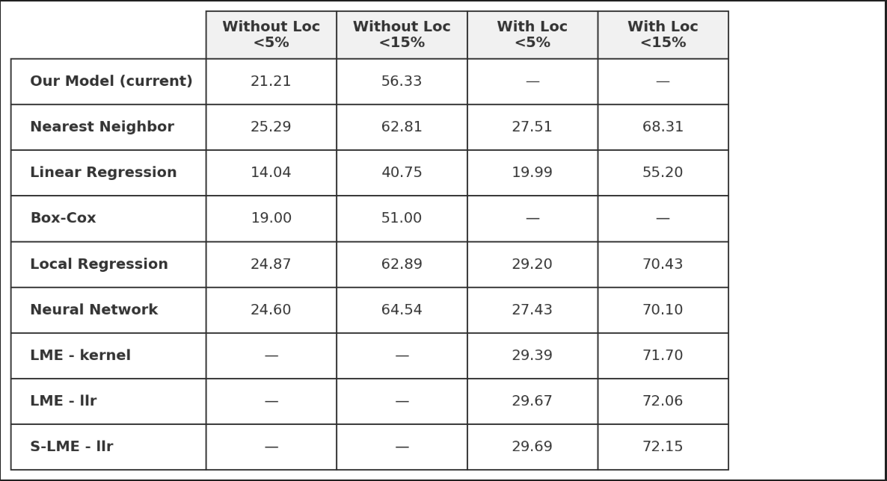
Results

Slide 13
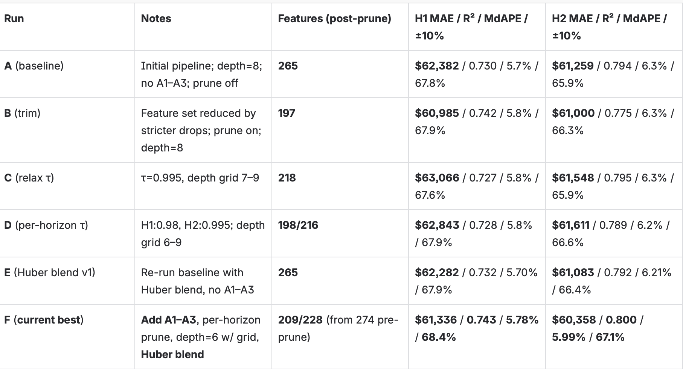

Slide 14
Conclusion and end product
Our ZIP×month hedonic AVA is a better fit than LME for our data and goals—time-keyed panel features, monotone GBDTs + a hedonic head give higher holdout accuracy, more stability in sparse ZIPs, and cleaner production ops. LME-style local smoothing still has potential, and we’re actively tuning (quantile/Huber losses, spatial encodings, reliability weights, calibration), but today our stack outperforms LME.
The end product is an end-to-end ML pipeline with a conversational UI: users ask in natural language (“3BR near top schools under $600k”), get transparent price drivers, comps and market “waterline,” and ranked home recommendations optimized for fit, affordability, and time-to-sell.

